Slide 1
Tumor Tissue Classification
Lab Group 8: Serkan Arda Yilal, Spandana Akumalla and Patrik Svensson

Slide 2
Overview of Project
Good quality dataset with healthy/tumor tissue images
Classifier project
Investigate how some parameters affect the result
Image resolution
Activation function
CNN dense layer neurons
Classification dense layer neurons
Using pretrained model (transfer learning) vs our model
Compare models using metrics like AUROC, accuracy, precision, and recall.

Slide 3
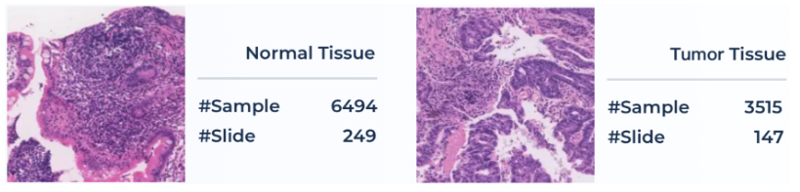
Dataset
From medfm2023 grand challenge (https://medfm2023.grand-challenge.org/)
10009 images of colon tissue
2 classes: 6494 healthy, 3515 with tumor
Resolution 1024x1024 pixels

Slide 4
Data Preparation
Memory limitations
Lower resolution (256x256 and 128x128)
Subset of data set - 4000 images - equal classes - Black-and-white (For our models)
Subset of data set - 1500 images - equal classes - RGB (For pretrained models)
No augmentation
3-fold cross validation
Image normalization
Shuffle data
3 sets of ⅔ training data and ⅓ of validation
Class Distribution check in each fold
Input to model
Notes:
Loading more than 4000 gave kernel death in the experiments. Balanced sets.

Slide 5
Model Architecture
Base Model: We have chosen to build our models on the foundations of VGG16 and ResNet50
Choice of Models: VGG16’s simplicity and ResNet50’s deep architecture with residual connections
Custom Layers: In customizing our models, we have incorporated global average pooling, fully connected layers and dropout layers to adapt the architecture to our special needs.
Activation Functions: First fully connected layer ReLu , Second fully connected layer Tanh.
Output layer: The output layer employs one neuron with a sigmoid activation function, a natural choice for binary classification.
Model structure: Our neural network features a hierarchical structure, starting with convolutional layers, transitioning to global average pooling and fully connected layers.

Slide 6
Hyperparameters
We employed manual tuning for hyperparameter optimization.
Initially we manually selected a broad range of hyperparameters to establish a baseline model.
Subsequently , we explored various combinations of hyperparameters, including activation functions, the number of dense layer neurons for classification and convolutional layers.
Learning rate:0.0001,
Batch Size: 32, Epochs: 125.
Regularization (L2 Reg): L2 regularization is set at 0.0001 ,
Dropout: 0.2
Loss Function: Binary Cross Entropy
Activation Function: ReLu and Tanh
Classification Layers: [[32,32],[64,64],[128,128]]
Convolutional Neurons: [8, 16, 32]
Notes:
This allowed us to systematically search for optimal hyperparameters while minimizing human bias

Slide 7
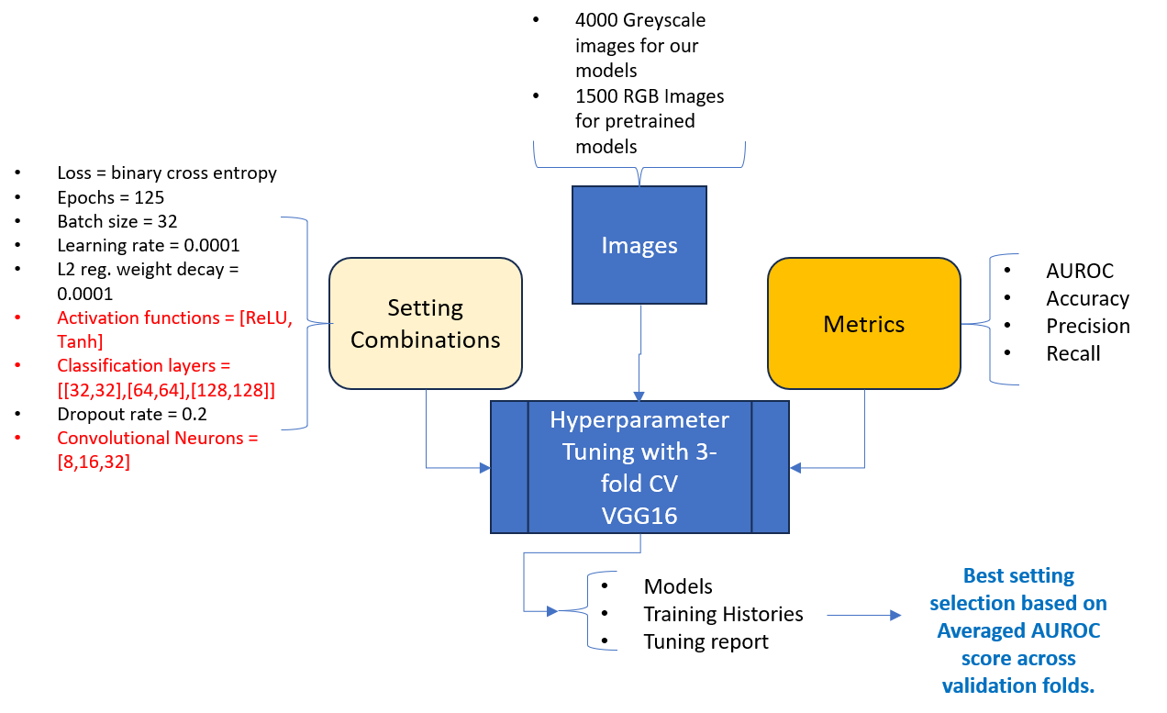
Training Process
The training process is performed using Adam as the optimizer.
The best models for each fold are saved based on validation performance using modelcheckpoint callbacks.
The best performing model based on the area under the ROC curve score is calculated on the validation data.
ResNet50 Model training process was computationally intensive.
VGG16 on the hand was less complex compared to ResNet50. Hence, VGG16 was chosen as model architecture for experiments in this project.

Slide 8
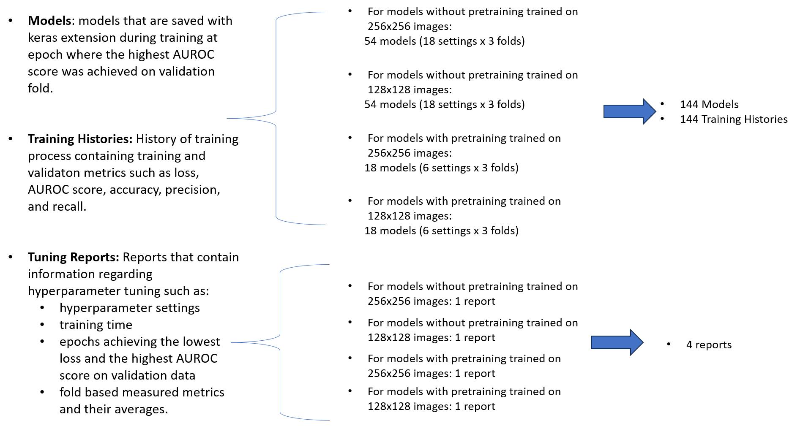
Results: Generated Files

Slide 9
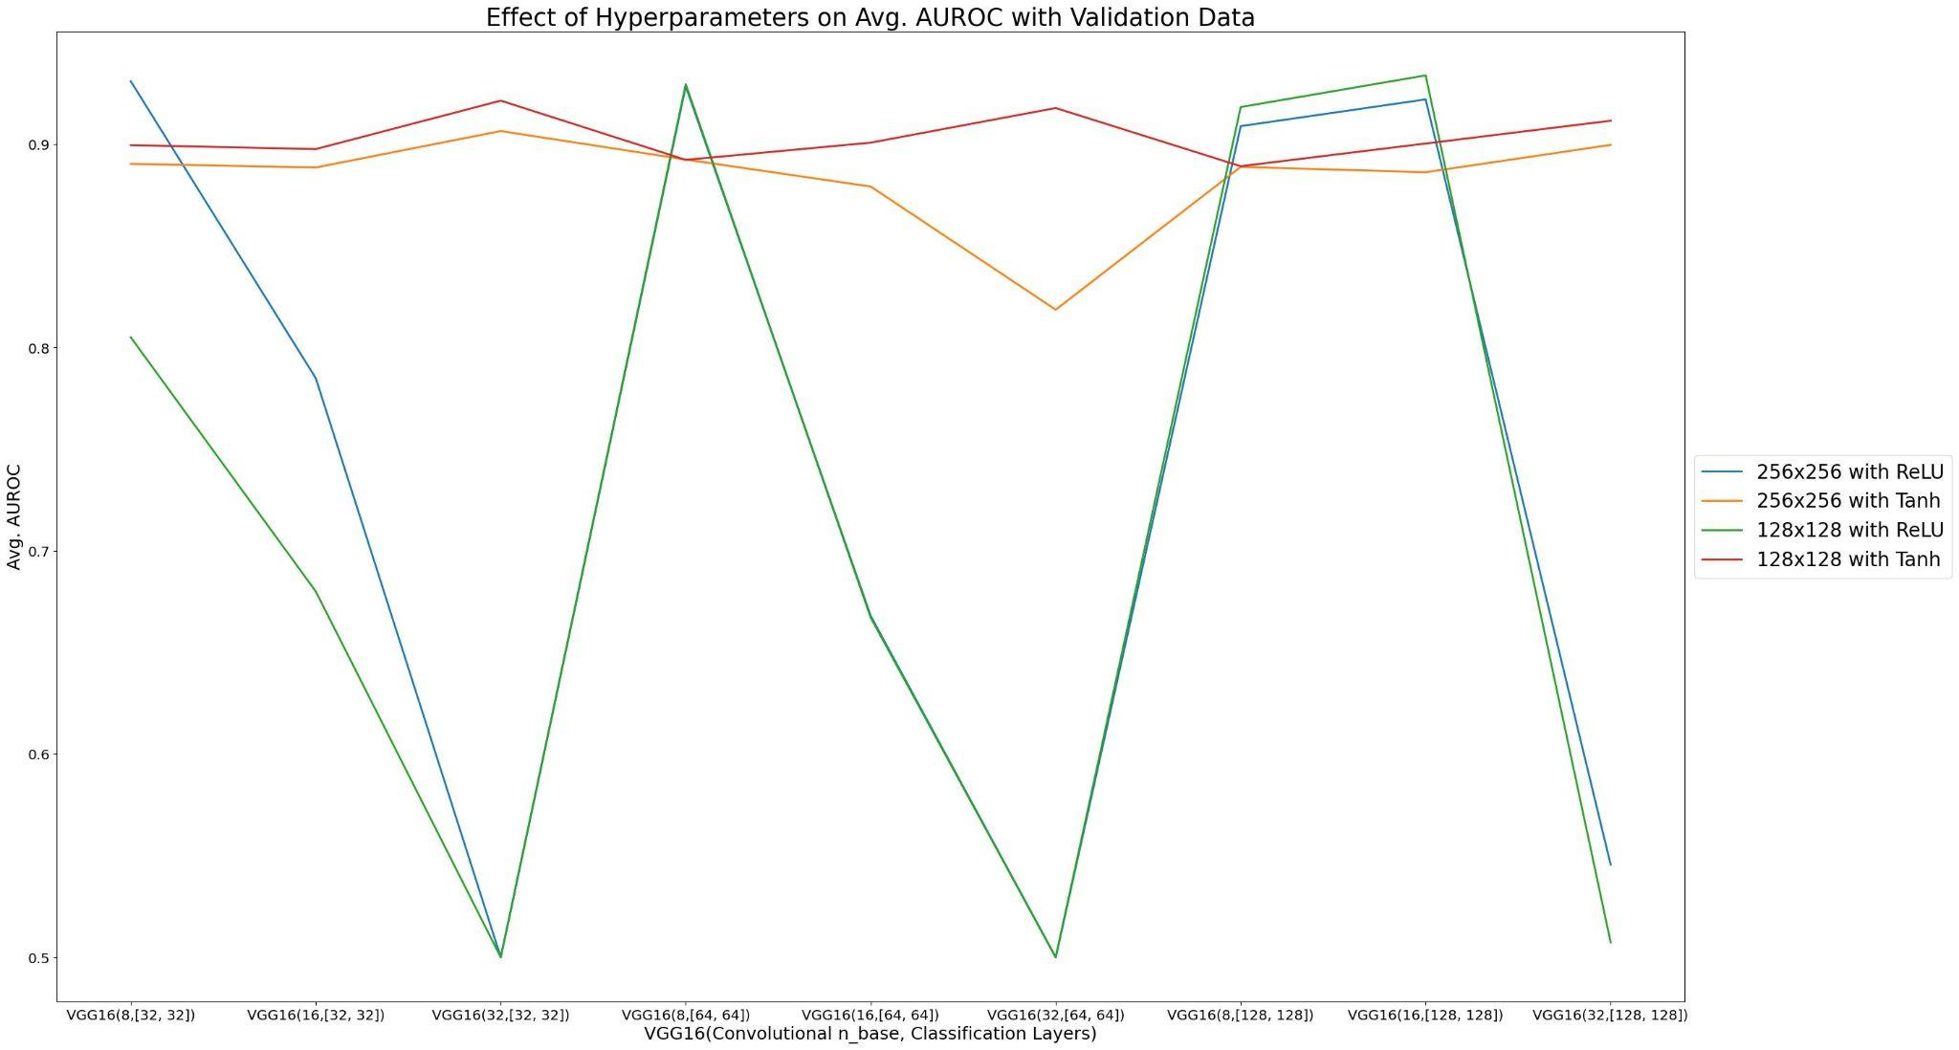
Results: Effect of Hyperparameters on Avg. AUROC

Slide 10
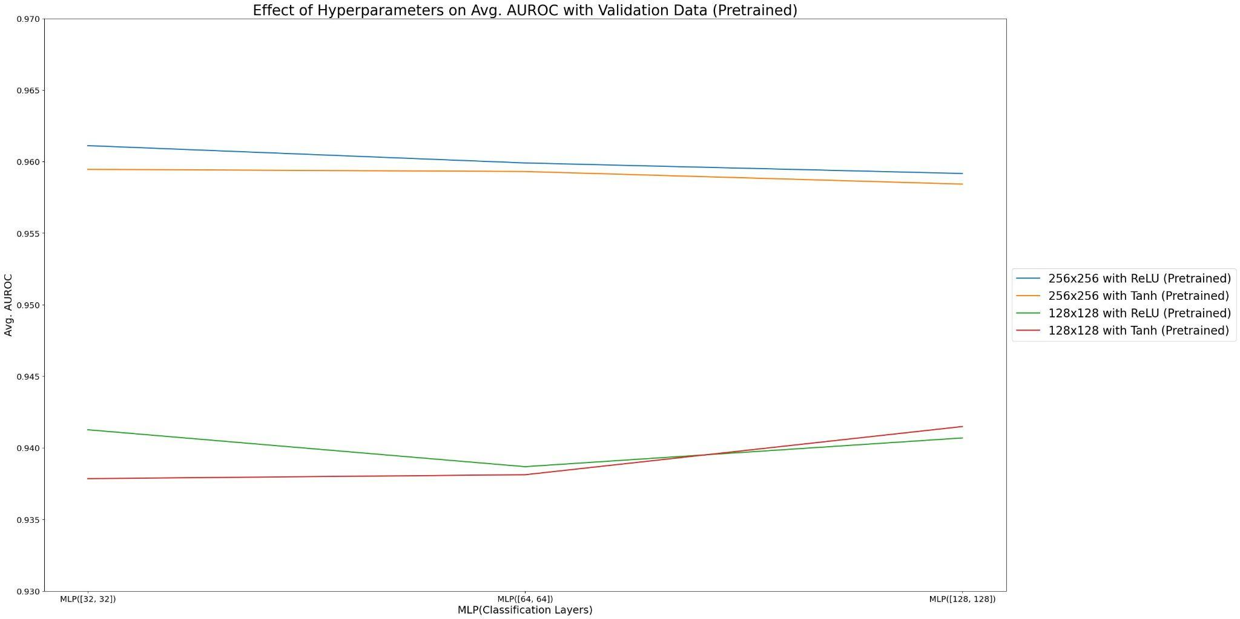
Results: Effect of Hyperparameters on Avg. AUROC

Slide 11
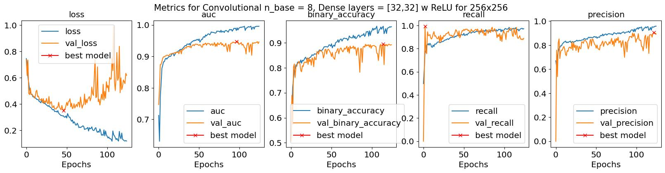
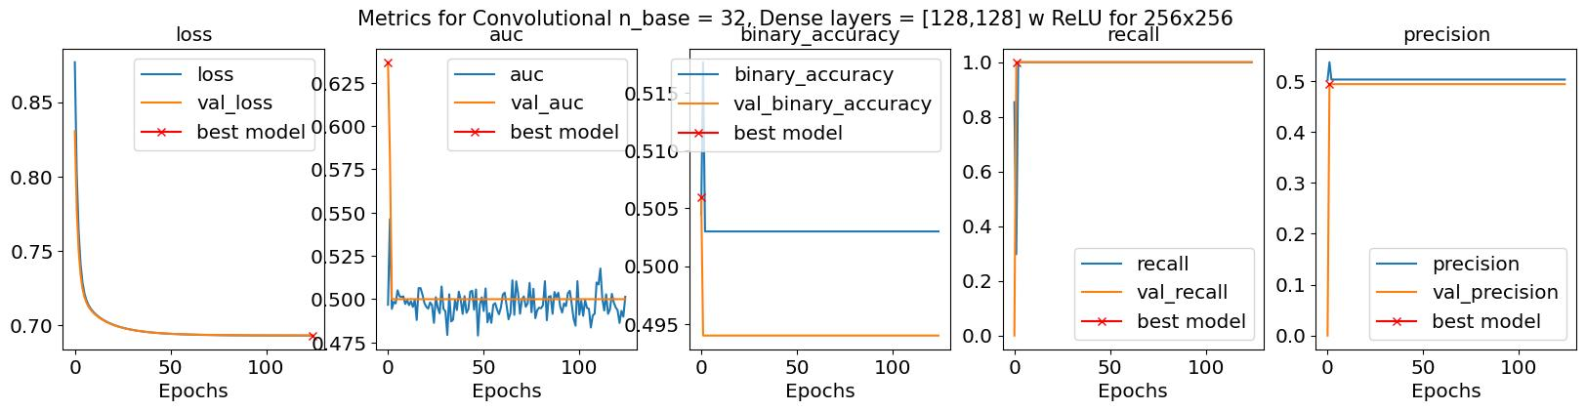
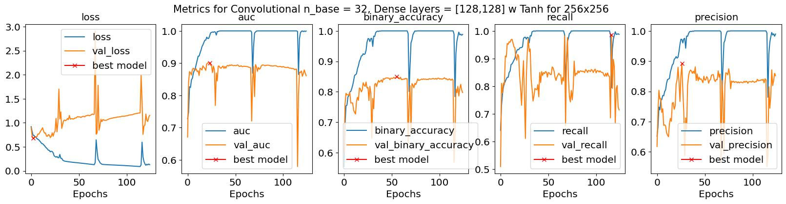
Results: Metric Trends

Slide 12
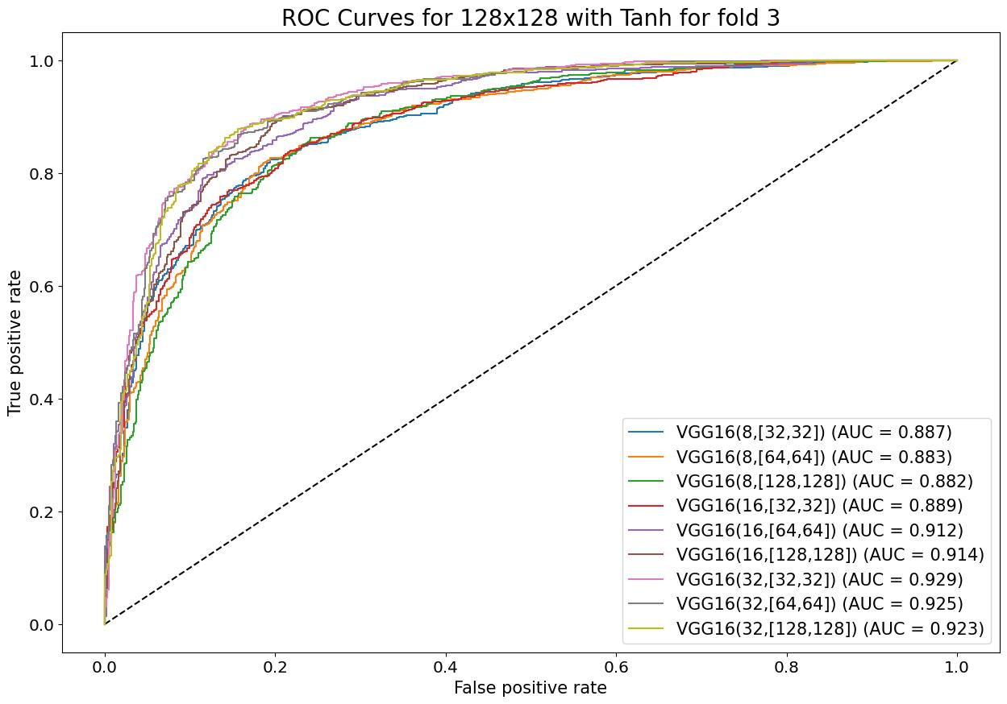
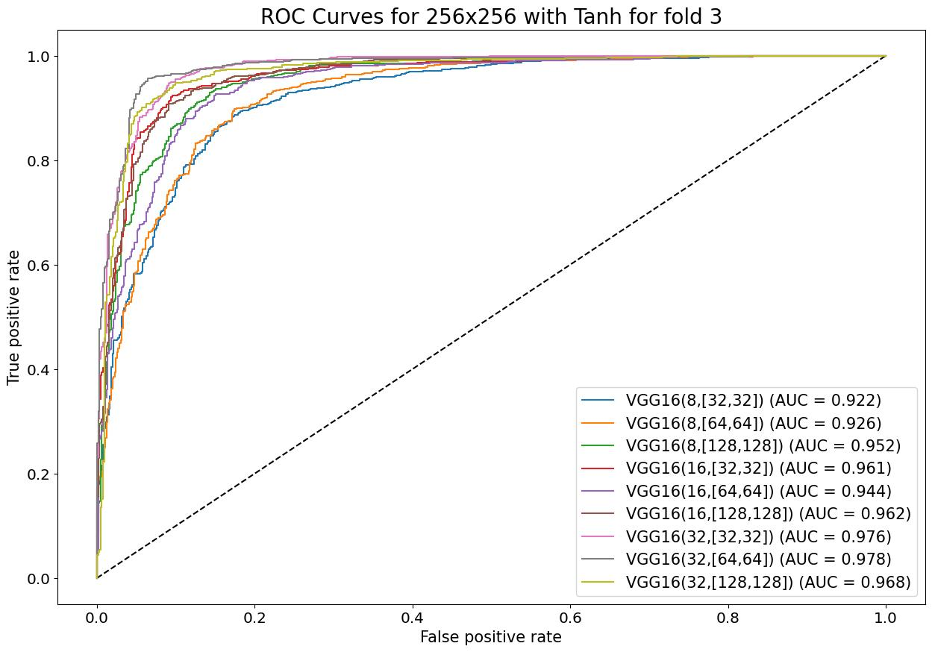
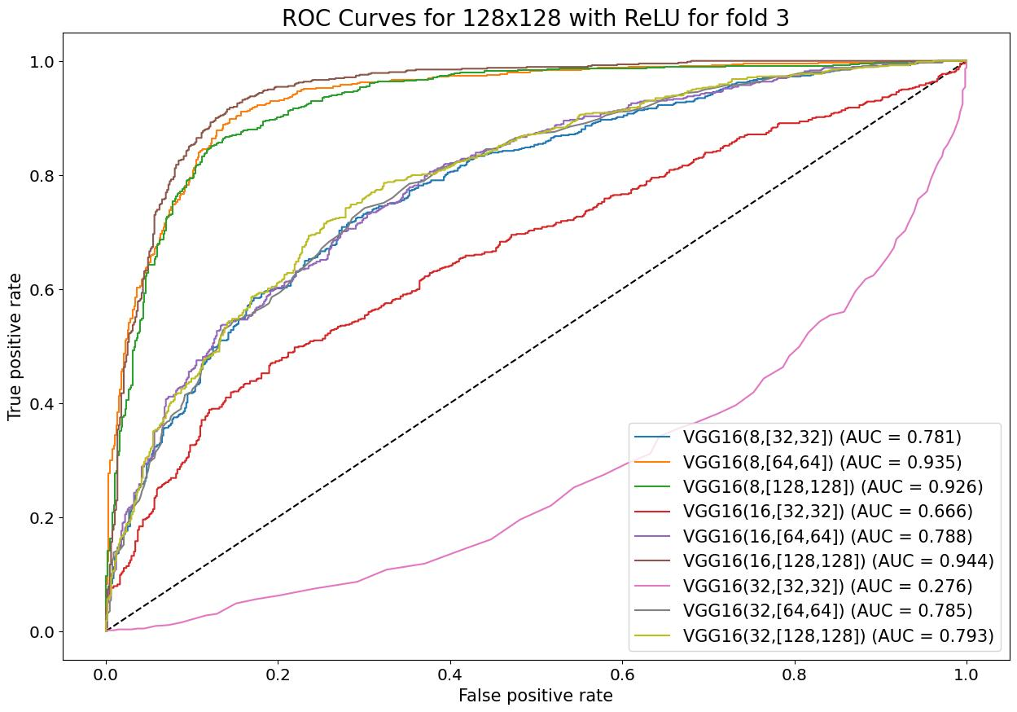
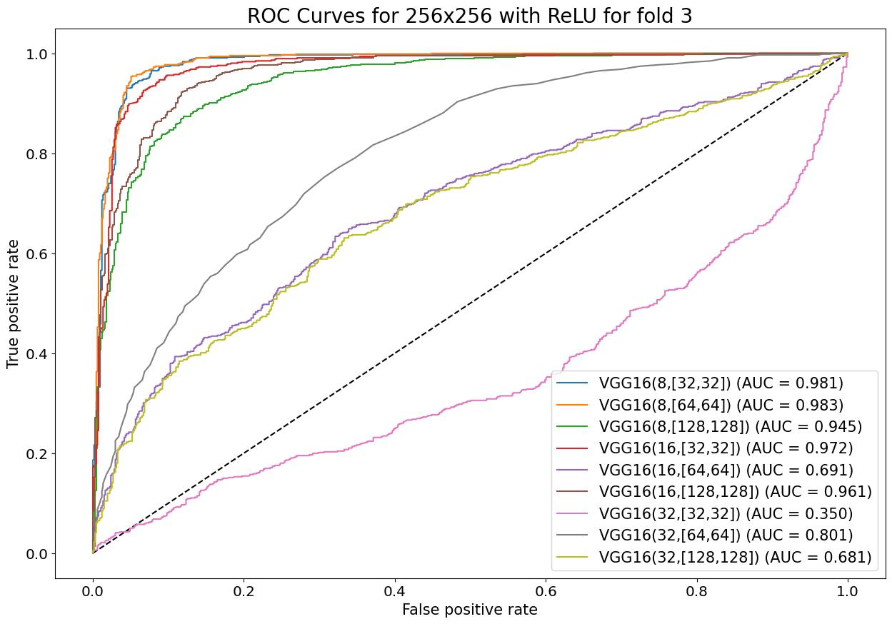
Results: AUROC Plots

Slide 13
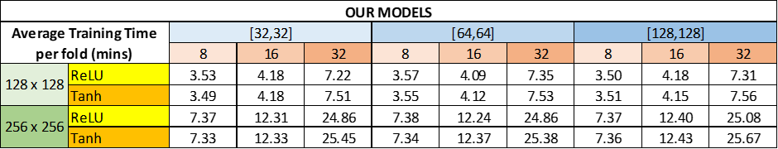
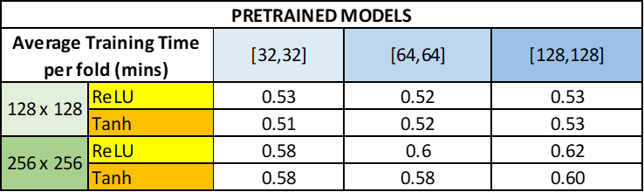
Results: Training Time Comparisons
Class.
Layers
Convol.
Neurons
Image Size
Act. Func.
Class.
Layers
Image Size
Act. Func.

Slide 14
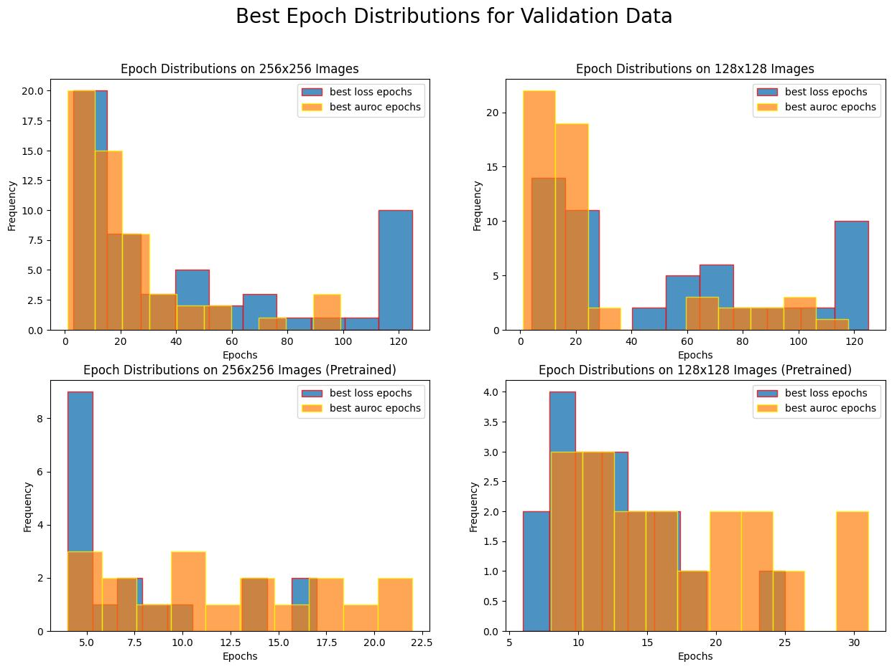
Results: Epoch Distribution

Slide 15
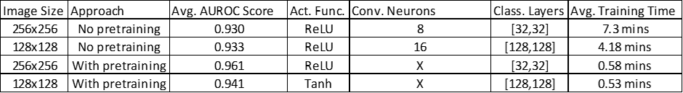
Conclusions
The pretrained models achieved higher avg. AUROC score on validation data.
The pretrained models were trained faster than our models.
ReLU activation function achieved most of the highest scores but it was less stable than Tanh in general across the folds considering worse performance in more complex networks.
Convolutional layers for our models seem to need more regularization such as spatial dropout, batch normalization etc.
The factors that affect the training time the most are image size, convolutional layer neurons, and usage of a pretrained model.
Although the highest AUROC score epochs and the lowest loss epochs behave similarly, they should not be used as indicators of each other completely.

Slide 16
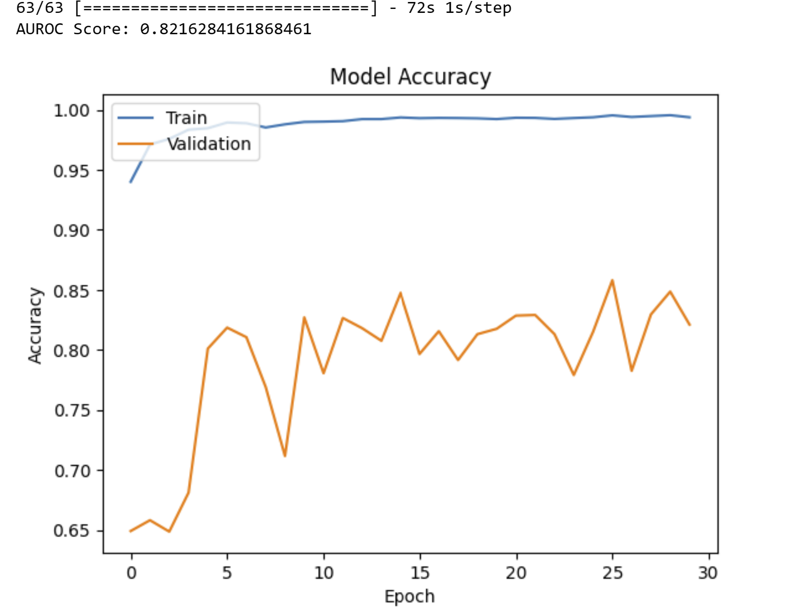
ResNet50 Model results

